Slide 1
Python Libraries for Machine Learning
MLDA@EEE

Slide 2
Learning Objectives
Introduction to the concept of a library and why we need them
Numpy, pandas, seaborn (matplotlib)
Scikit-learn for Data Science
TensorFlow and PyTorch for Machine Learning
Supplementary libraries to help you eliminate inefficiencies

Slide 3
How I plan conduct today’s workshop
1
2
3
4
5
Interactive
I want today’s session to be a conversation so we can learn as a collective group
Wont’ be going into too much detail
This workshop is mainly for you guys to get an appreciation and understanding of python libraries
Hand’s On
Today’s session will be very hands on so get your google Collaboratory notebooks ready!
Questions
Will be encouraged!
No Cheat sheets!!
I need you to get used to looking at documentation!

Slide 4
2 Routes for the Workshop
Normal
Express
The Normal track is basically the track for people who are completely new to concepts being taught today. If you are, don't worry that's why you are here to learn!
If you already have some of the background knowledge for today's workshop, you can try out the exercises now if you want to.

Slide 5
Today’s Agenda
What is a Library
Scikit-learn
Summary
A basic introduction to libraries and the mindset behind them
For Data Science
NumPy
Pandas
Matplotlib/Seaborn
For Machine Learning
The Big 3
TensorFlow/PyTorch

Slide 6
Express Exercise (I)
The “Secret Service” has hired you to create a library called numCraft that deals with 2 arrays each picked up by the sensor from their military aircraft. Your job is to create a library that does the following functions:
Get the average of the altitude from both the sensors
Transpose the second array and return it
Do a matrix multiplication of both the arrays

Slide 7
Express Exercise (Link)
https://colab.research.google.com/drive/1KoF6ZeP3Jkcpnic3f70wcP_TN9czZzSr?usp=sharing

Slide 8
Classes & OOP a recap
Very Important to understand Libraries

Slide 9
Classes
Class Adder:
def __init__(self):
self.x = 7
self.y = “Max”
def add(num_1, num_2): # Method
return num_1, num_2
import
You

Slide 10
Calling a method of aclass
adder_class = Adder()
adder_class.add(1, 2)
# This will return 3
import
You

Slide 11
What & Why Libraries?
Why have them in the first place?

Slide 12
What is a “Traditional” Library?
It is a location where people, who have experimented and know something about a subject write down their ideas for other people to use them.
If you want to learn something back in the olden days, you would have to go to a library and read a book on the subject.

Slide 13
A useful Analogy!
Library
F=ma
F=ma
Hey I want to predict the motion of a thrown ball
Issac Newton
You

Slide 14
A useful Analogy!
NumPy
numpy.add()
numpy.add()
Hey I have 2 lists, I want to add them!
API Developers
You

Slide 15

The Structure of a Library
numpy.zeros(shape=5)
= [0, 0, 0, 0, 0]
You

Slide 16
Today’s Agenda
What is a Library
Scikit-learn
Summary
A basic introduction to libraries and the mindset behind them
For Data Science
NumPy
Pandas
Matplotlib/Seaborn
For Machine Learning
The Big 3
TensorFlow/PyTorch

Slide 17
Express Exercise (II)
Try using the NumPy library now to replicate the same result as of exercise one

Slide 18
The essential 3 to get started
What everyone should take to their gravestone

Slide 19
The 3 essential
NumPy
Pandas
Matplotlib
import numpy as np
import pandas as pd
import matplotlib.pyplot as plt
NumPy is essentially the library that you will be using when it comes to dealing with arrays (essentially lists where you can do higher-order computations on).
Pandas is essentially the library that is mainly used to extract and manage data from an external source, like from a CSV file in a local directory for example.
Matplotlib and Seaborn will mostly be used for visualizing your results.

Slide 20
Steps for Data Science
Understand the Problem
Machine Learning
Data Extraction
pandas
Feature Selection
Data Cleaning
numpy/pandas
Analyze/Visualize the Data
You
matplotlib/seaborn

Slide 21
NumPy
Arrays! Arrays! Arrays!

Slide 22
Why use NumPy?
Well, Python does not have arrays built in, and since machine learning relies a lot on matrix computation, it is important to have a library for these things.
List of prices
Array of prices
np.array()
97 | 28 | 36 | 53 | 59
97 | 28 | 36 | 53 | 59

Slide 23
numpy.array()
import numpy as np
list_of_prices = [97, 28, 36, 53, 59]
print(type(list_of_prices))
array_of_prices = np.array(list_of_prices)
print(type(array_of_prices))
import
You

Slide 24
numpy.add()
Array of prices
97 | 28 | 36 | 53 | 59
+
GST Inclusion
8 | 3 | 3 | 4 | 5
=
You
Prices with GST
105 | 31 | 39 | 57 | 64

Slide 25

numpy.add()
import numpy as np
array_of_prices = np.array([97, 28, 36, 53, 59])
gst_inclusion= np.array([8, 3, 3, 4, 5])
prices_with_gst = np.add(array_of_prices, gst_inclusion)
print(prices_with_gst)
import
You

Slide 26
numpy.subtract()
Array of prices
97 | 28 | 36 | 53 | 59
-
Discount Inclusion
8 | 3 | 3 | 4 | 5
=
You
Prices after discount
89 | 25 | 33 | 49 | 54

Slide 27

numpy.subtract()
import numpy as np
array_of_prices = np.array([97, 28, 36, 53, 59])
discount_inclusion= np.array([8, 3, 3, 4, 5])
prices_after_discount = np.subtract(array_of_prices, discount_inclusion)
print(prices_after_discount)
import
You

Slide 28
NumPy 2D Array?
It is essentially just a numpy array that we have seen earlier, but with rows and column
1500 | 1200
5000 | 6520
7000 | 6000
8000 | 8001
12000 | 11999
Notes:
Mention that it is a lost of lists to make things easier

Slide 29
numpy.transpose()
1500 | 1200
5000 | 6520
7000 | 6000
8000 | 8001
12000 | 11999
1500 | 5000 | 7000 | 8000 | 12000
1200 | 6520 | 6000 | 8001 | 11999
You

Slide 30
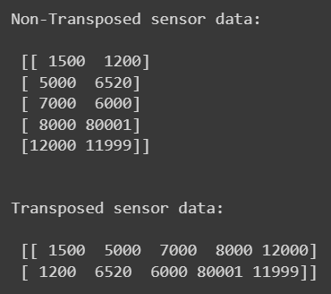
numpy.transpose()
import numpy as np
sensor_data = np.array([[1500, 1200], [5000, 6520], [7000, 6000], [8000, 80001], [12000, 11999]])
print(f"Non-Transposed sensor data:\n\n {sensor_data}")
transposed_sensor_data = np.transpose(sensor_data)
print(f“\n\nTransposed sensor data:\n\n {transposed_sensor_data}")
import
You

Slide 31
numpy.reshape()
import numpy as np
sensor_data = np.array([[1500, 1200], [5000, 6520], [7000, 6000], [8000, 80001], [12000, 11999]])
print(f"Non-Transposed sensor data:\n\n {sensor_data}")
transposed_sensor_data = np.reshape(sensor_data,
(2, 5))
print(f“\n\nTransposed sensor data:\n\n {transposed_sensor_data}")
import
You

Slide 32
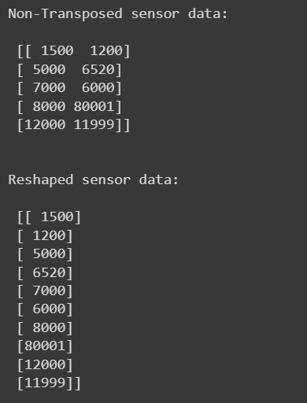
numpy.reshape()
import numpy as np
sensor_data = np.array([[1500, 1200], [5000, 6520], [7000, 6000], [8000, 80001], [12000, 11999]])
print(f"Non-Transposed sensor data:\n\n {sensor_data}")
transposed_sensor_data = np.reshape((-1, 1))
print(f“\n\nReshaped sensor data:\n\n {transposed_sensor_data}")
import
You

Slide 33
Pandas
Data! Data! Data!

Slide 34
Why use Pandas?
Pandas provides a convenient way for you to get the data from your local directory be it from a CSV file or a JSON file and manage it in your console

Slide 35
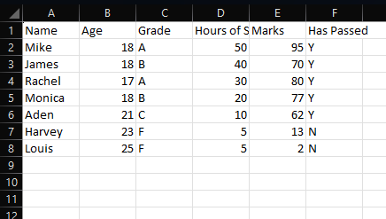
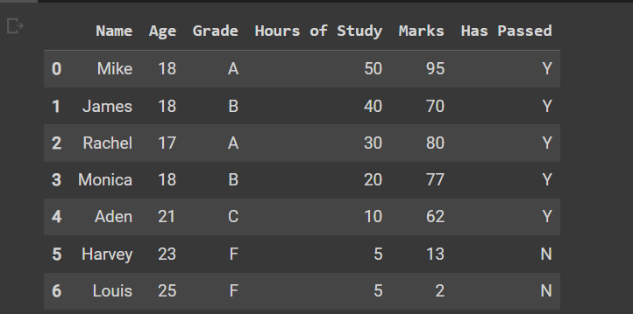
pandas.read_csv
Excel sheet from local directory
pd.read_csv(“Local File Name”)
You

Slide 36
pandas.read_csv()
import pandas as pd
extracted_data_from_csv = pd.read_csv(“Grades Workbook.csv")
extracted_data_from_csv
import
You

Slide 37
pandas.read_csv()
import pandas as pd
extracted_data_from_csv = pd.read_csv("Example Workbook.csv")
type(extracted_data_from_csv)
import
You

Slide 38
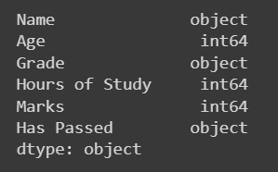
pandas.DataFrame.dtypes
import pandas as pd
extracted_data_from_csv = pd.read_csv("Grades Workbook.csv")
extracted_data_from_csv.dtypes
import
You

Slide 39
pandas.DataFrame.loc()/iloc()
Name | Grade
Mike | A
James | B
Rachel | A
Monica | B
Name
Mike
James
Rachel
Monica
.iloc[:, 0]
.loc[:, “Name”]
Name
Mike
James
Rachel
Monica
You
Notes:
For LOC you can mention it as location and for ILOC you can mention it as index location for better retention and memory

Slide 40
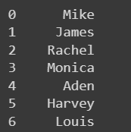
pandas.DataFrame.loc()/iloc()
import pandas as pd
extracted_data_from_csv = pd.read_csv("Grades Workbook.csv")
name_column_num = extracted_data_from_csv.iloc[:, 0]
name_column = extracted_data_from_csv.loc[:, “Name”]
extracted_data_from_csv.describe()
import
You

Slide 41
One Important Data Cleaning Library
Name | Grade
Mike | A
James | B
Rachel | NaN
NaN | B
.dropna(axis =0)
Name | Grade
Mike | A
James | B
.dropna(axis =1)
You

Slide 42

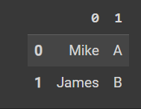
pandas.DataFrame.dropna
import pandas as pd
extracted_data_from_csv = pd.read_csv("Grades Workbook.csv")
cleaned_data = extracted_data_from_csv.dropna(extracted_data_from_csv, axis = 0)
cleaned_data = extracted_data_from_csv.dropna(extracted_data_from_csv, axis = 1)
cleaned_data
import
You

Slide 43
Matplotlib/Seaborn
The importance of visualizing your data

Slide 44
What are the different types of data?
Data
Categorical
Numerical
Cat plot
Nominal
Discrete
Bar plot
You
Ordinal
Continuous
Line plot, Scatter plot, Histogram (kde plot)

Slide 45
Analyzing your data
Discrete
Which one is discrete and which one is continuous?
You
Discrete

Slide 46
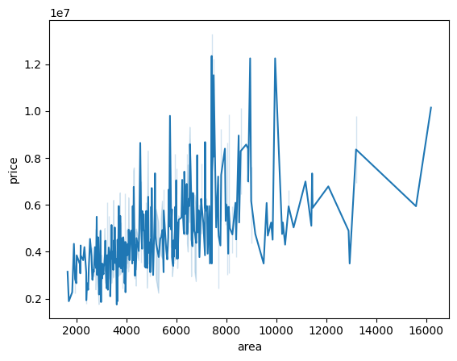
seaborn.lineplot()
import pandas as pd
extracted_data_from_csv = pd.read_csv(“Housing_Dataset.csv")
price_area_df =
extracted_data_from_csv.loc[:, ["area", "price"]]
sb.lineplot(price_area_df)
import
You
Notes:
Mention that Seborn is built on top of matplitlib

Slide 47
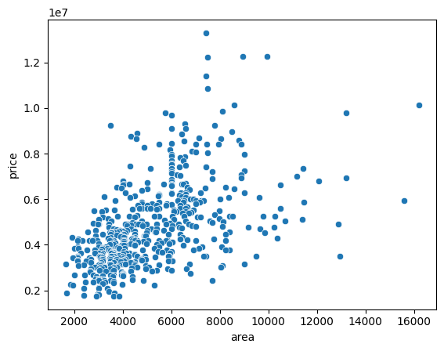
seaborn.scatterplot()
import pandas as pd
extracted_data_from_csv = pd.read_csv(“Housing_Dataset.csv")
price_area_df =
extracted_data_from_csv.loc[:, ["area", "price"]]
sb.scatterplot(price_area_df)
import
You

Slide 48
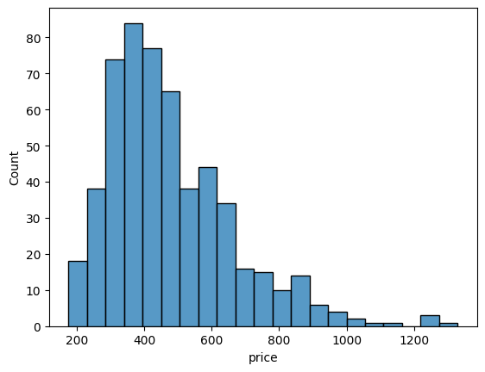
seaborn.histplot()
import pandas as pd
extracted_data_from_csv = pd.read_csv(“Housing_Dataset.csv")
price_df=
extracted_data_from_csv.iloc[:,0]
sb.histplot(list_of_marks)
import
You

Slide 49
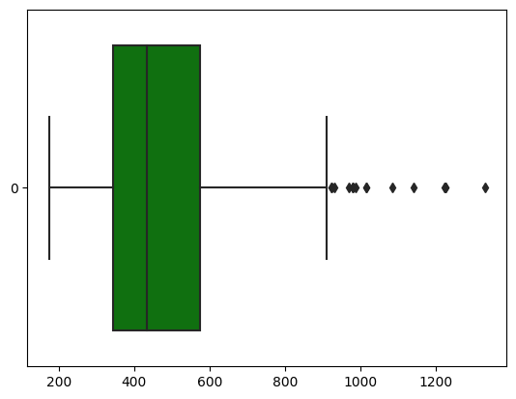
seaborn.boxplot()
import pandas as pd
extracted_data_from_csv = pd.read_csv(“Housing_Dataset.csv")
price_df=
extracted_data_from_csv.iloc[:,0]
sb.boxplot(data = price_df, orient = h, color=‘green)
import
You
Notes:
The middle value represents median while the left and right the 25 & 75 percentiles accordingly

Slide 50
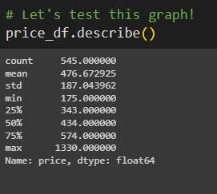
Let’s Compare
import
import
You

Slide 51
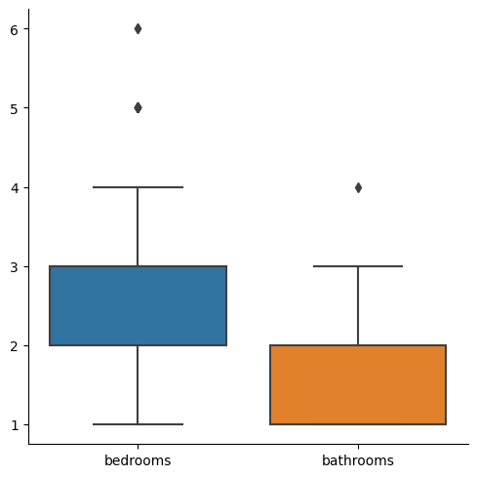
seaborn.catplot()
import pandas as pd
extracted_data_from_csv = pd.read_csv(“Housing_Dataset.csv")
price_df=
extracted_data_from_csv.loc([:,[“bedrooms”, “bathrooms”]])
sb.catplot(data = price_df, kind=‘box’)
import
You

Slide 52
Workflow
What is a Library
Scikit-learn
Summary
A basic introduction to libraries and the mindset behind them
For Data Science
NumPy
Pandas
Matplotlib/Seaborn
For Machine Learning
The Big 3
TensorFlow/PyTorch

Slide 53
Scikit-learn
Let’s talk more Data Science!

Slide 54
What are the different types of data?
Data Science
Data Preprocessing
Regression
Classification
Clustering
Continuous
Discrete
Discrete
You

Slide 55
Data Pre-processing libraries
Pre-Processing Libraries
Imputer
Standard Scaler
Label Encoder
Train-test split
You

Slide 56
Imputer
1500 | 1200
NaN | 6520
7000 | NaN
8000 | 8001
12000 | 11999
1500 | 1200
7,125 | 6520
7000 | 6930
8000 | 8001
12000 | 11999
You

Slide 57
sklearn.impute.SimpleImputer()
from sklearn.impute import SimpleImputer
imputer = SimpleImputer(missing_values = np.nan, strategy = ‘mean’)
# Note that you can have other strategies
imputer.fit_transform(array)
import
You

Slide 58
Standard Scaler
1500 | 10
5000 | 20
7000 | 57
8000 | 63
12000 | 71
13 | 5
14.5 | 10
16 | 16
20 | 13
22 | 15
You

Slide 59
sklearn.preprocessing.StandardScaler()
from sklearn.preprocessing import StandardScaler
scaler = StandardScaler()
scaler.fit_transform(array)
scaler.inverse_transform(array)
import
You

Slide 60
Label Encoder
Country | Temperature
Singapore | Low
Japan | High
HongKong | Medium
Germany | High
Country | Temperature
Singapore | 0
Japan | 2
HongKong | 1
Germany | 2
You

Slide 61
sklearn.preprocessing.LabelEncoder()
from sklearn import preprocessing
encoder = preprocessing.LabelEncoder()
encoder.fit_transform(array)
encoder.inverse_transform(array)
import
You

Slide 62
Train-Test Split
Training-Set
Temperature | Number of Ice-Creams Sold
25 | 100
27 | 150
Temperature | Number of Ice-Creams Sold
25 | 100
27 | 150
31 | 250
30 | 300
Test-Set
Temperature | Number of Ice-Creams Sold
31 | 250
30 | 300
You

Slide 63
Why Train-Test Split?
Training-Set
Predictions
Temperature | Number of Ice-Creams Sold
25 | 100
27 | 150
Temperature | Number of Ice-Creams Sold
31 | 230
30 | 305
Trains your model
Test-Set
Compare
Temperature | Number of Ice-Creams Sold
31 | 250
30 | 300

Slide 64
sklearn.model_selection.train_test_split()
from sklearn.model_selection import train_test_split
X_train, X_test, y_train, y_test = train_test_split(X, y, test_size = 0.3)
import
You

Slide 65
What is Regression?
It is synonymous with the line of best fit that you had learned in your high school years.
You get a line that best fits the scatterplot and predict the y value from the known x variable.

Slide 66
Regression in a Nut-Shell
≈ 150
You

Slide 67
sklearn.linear_model.LinearRegression()
from sklearn.linear_model import LinearRegression
regressor = LinearRegression()
regressor.fit(temperature, number_of_icecreams_sold)
regressor.predict(new_temperature)
import
You

Slide 68
What is Classification?
It is the process of plotting data based on “known groups”.
So when a new data point is introduced, the distance between each group and that new data point is compared. The new data point is assigned to the group with the lowest distance.

Slide 69
Logistic Regression in a Nut-Shell
You

Slide 70
sklearn.linear_model.LogisticRegression()
from sklearn.linear_model import LogisticRegression
regressor = LogisticRegression()
regressor.fit(grades, has_passed)
regressor.predict(new_student_grade)
import
You

Slide 71
What is Clustering?
It is the process of categorizing data based on “unknown groups”.
So when a new data point is introduced, the distance between each group and that new data point is compared. The new data point is assigned to the group with the lowest distance.

Slide 72
Look at this Chart!

Slide 73
sklearn.cluster.KMeans
from sklearn.cluster import Kmeans
kmeans = KMeans(n_clusters=2).fit(hours_studied)
kmeans.predict(hours_studied_new)
import
You

Slide 74
Think you have understood the concepts? Let’s try them out!
https://colab.research.google.com/drive/1-IRljPEB6G0Q84FouKSls_Dd_9EvhT8S?usp=sharing

Slide 75
TensorFlow/PyTorch
Don’t Memorize

Slide 76
What is an Artificial Neural Net?
This structure that takes inspiration from the human brain and how it learns is through repetition and error.
Just like a human, it leans through its mistakes and updates its “brain” accordingly.

Slide 77







Artificial Neural Networks
Back-propagated
Loss
You

Slide 78





Artificial Neural Networks
Back-propagated
Activation Function
Activation Function
Activation Function
Activation Function
Activation Function
Activation Function
Loss
You
Activation Function

Slide 79
What is an Activation Function?
It is basically the mathematical function that introduces an element of non-linearity into your models.
Without the activation function, it basically reduces the overall model into a linear regression model.
More-over, it is important to have a bias and non-linearity so the model can pick-up on unusual patterns

Slide 80

Importing the essential libraries for a Neural Network
PyTorch
TensorFlow
import torch
import torch.nn as nn
import torch.nn.functional as F
import tensorflow as tf
from keras.models import Sequential
from keras.layers import Dense
You

Slide 81
Initializing a Neural Network
PyTorch
TensorFlow
class SimpleNN(nn.Module):
def __init__(self):
super(SimpleNN, self).__init__()
self.fc1 = nn.Linear(1, 10) # One input neuron (area) and 10 neurons in hidden layer
self.fc2 = nn.Linear(10, 1) # 10 input neurons from the hidden layer to one output neuron (price)
def forward(self,x):
x = self.fc1(x)
x = torch.relu(x) #Sneak peak!! non-linear activation function
x = self.fc2(x)
return x
nn = Sequential()
You

Slide 82
Initializing a Neural Network
PyTorch
TensorFlow
class SimpleNN(nn.Module):
def __init__(self):
super(SimpleNN, self).__init__()
self.fc1 = nn.Linear(1, 10) # One input neuron (area) and 10 neurons in hidden layer
self.fc2 = nn.Linear(10, 1) # 10 input neurons from the hidden layer to one output neuron (price)
def forward(self,x):
x = self.fc1(x)
x = torch.relu(x) #Sneak peak!! non-linear activation function
x = self.fc2(x)
return x
nn = Sequential()
nn.add(Dense(units=1, activation = “relu”, ))
nn.add(Dense(units=10, activation = “relu”, ))
nn.add(Dense(units=1, activation = “relu”, ))
You

Slide 83
Compiling a Neural Network
PyTorch
TensorFlow
import torch.optim as optim
#Mean squared error loss function
#Sneak peak!! MSE was chosen as it is a regression problem
criterion = nn.MSELoss()
#Stoicastic gradient descent, weight = weight - learning_rate * gradient
optimizer = optim.SGD(model.parameters(), lr=0.0001)
model.compile(loss="binary_crossentropy", optimizer="adam", metrics=[“mean_squared_error"])
You

Slide 84
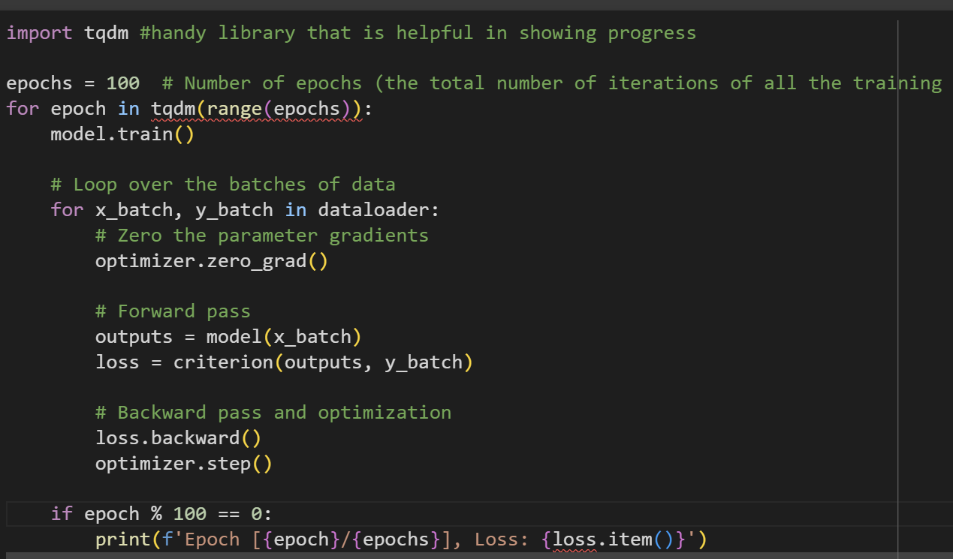
Training the Neural Network
PyTorch
You

Slide 85
Training the Neural Network
TensorFlow
model.fit(X,y, epochs=150, batch_size=10)
You

Slide 86
2 Things to focus on
Epochs
Adam
Basically the number of training iterations
Usually, the more the better, but ensure to not overfit your data
This is the stochastic gradient descent optimizer.
Essentially finds the minima of the error
Notes:
Explain Stochastic gradient descent on the board

Slide 87
Stochastic Gradient Descent
Cost function (Loss)
Weights
Notes:
Explain Stochastic gradient descent on the board

Slide 88
Weights Optimized
Cost function (Loss)
Weights
Notes:
Explain Stochastic gradient descent on the board

Slide 89
Supplementary Libraries
Just an FYI

Slide 90
Table of Libraries
Name | Method | What it does
Time | .time() | Records the time in which the function was called.
BeautifulSoup | .get(URL) | This module is mainly used for web-scrapping
Json | .loads(JSON String) | Converts a JSON string into a dictionary
OPENAI API | Multiple functions | https://platform.openai.com/docs/api-reference/introduction
OPENCV | Multiple functions | Mainly specialized in computer vision

Slide 91
Summary
Wow you have gotten this far!

Slide 92
Workflow
What is a Library
Scikit-learn
Summary
A basic introduction to libraries and the mindset behind them
For Data Science
NumPy
Pandas
Matplotlib/Seaborn
For Machine Learning
The Big 3
TensorFlow/PyTorch

Slide 93

Quiz + Final Exercise Colab
https://colab.research.google.com/drive/1-IRljPEB6G0Q84FouKSls_Dd_9EvhT8S?usp=sharing
Notes:
Explain Stochastic gradient descent on the board

Slide 94
Thank you
Aditya Sivadas

Slide 95
Data References
https://www.kaggle.com/datasets/yasserh/housing-prices-dataset

Slide 96
References
https://www.geeksforgeeks.org/implementing-web-scraping-python-beautiful-soup/
https://www.springboard.com/blog/data-science/python-libraries-for-machine-learning/
https://www.springboard.com/blog/data-science/python-libraries-for-machine-learning/

